Slide 1
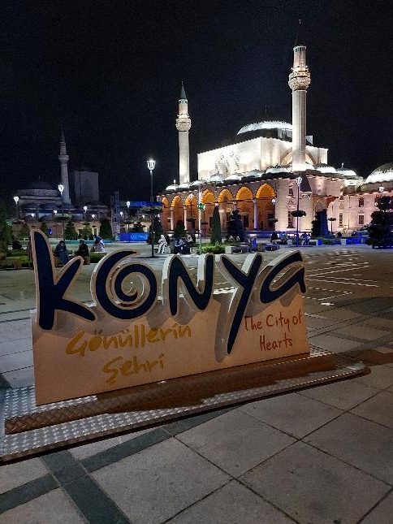
Photo Album
“AUTISM - They are on of us”
2019-1-TR01-KA201-077188
Final TPM Konya - TÜRKİYE
17-18 August 2022
by gabi

Slide 2
Diagnosis and placement process of individuals with autism in Turkye

Slide 3
Information sharing on educational practices - Presentation of work within the scope of “Autism, They Are All of Us” project

Slide 4
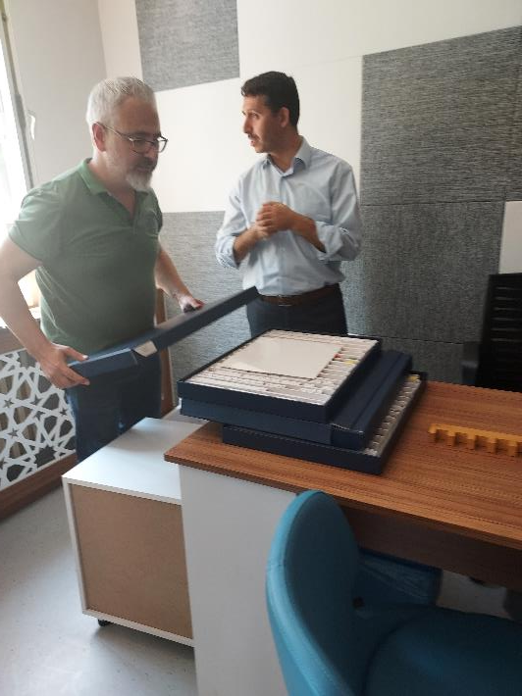
Visit to Meram Guidance Research Center

Slide 5
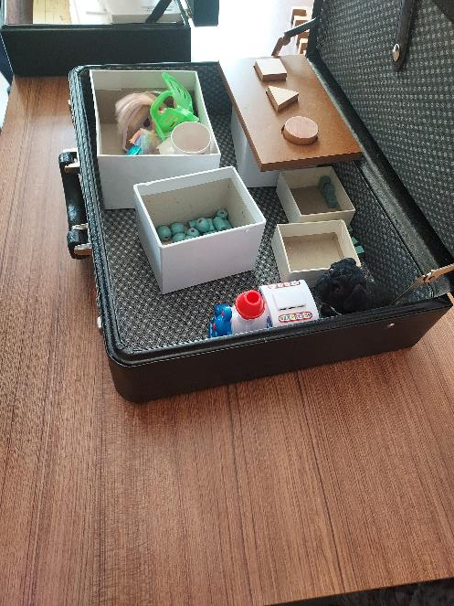
Meram Guidance Research Center Presentation

Slide 6
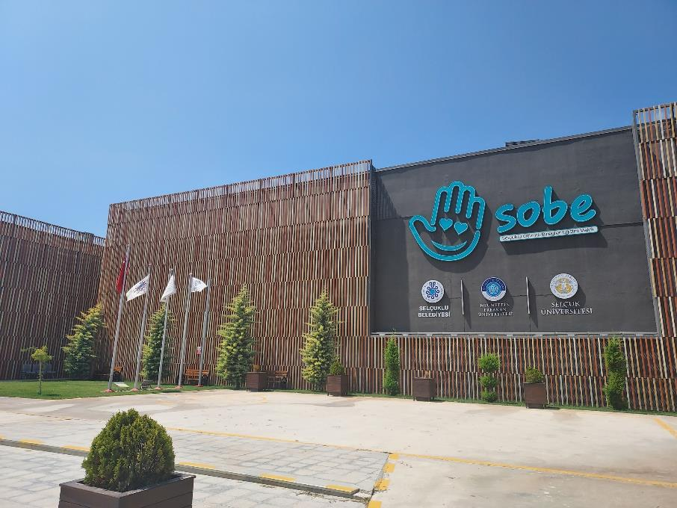
Visit to Selcuklu Autistic Individuals Education (SOBE) Foundation

Slide 7
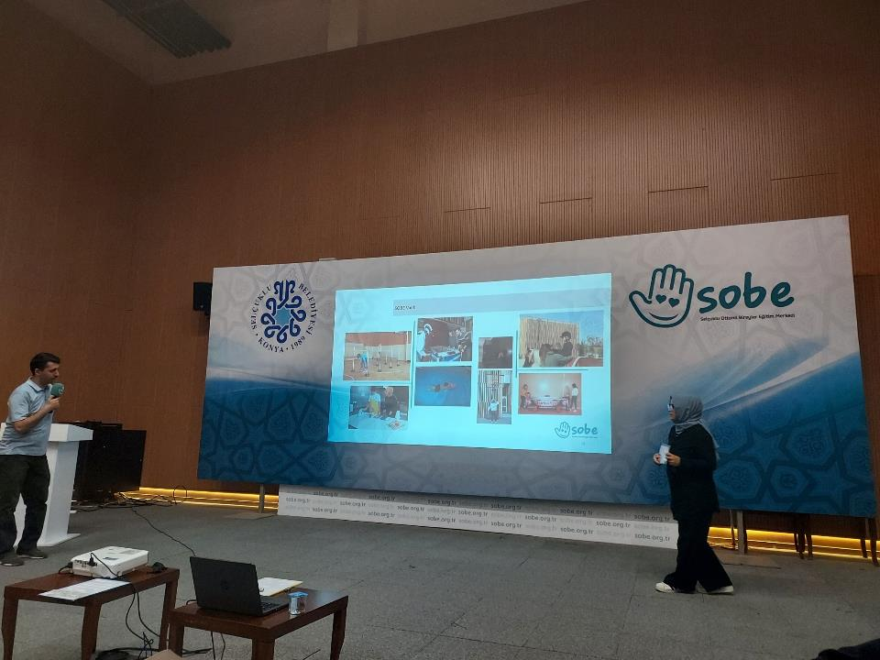
Visit to Selcuklu Autistic Individuals Education (SOBE) Foundation
Obtaining information about individual education practices for individuals with autism
Observing educational environments

Slide 8
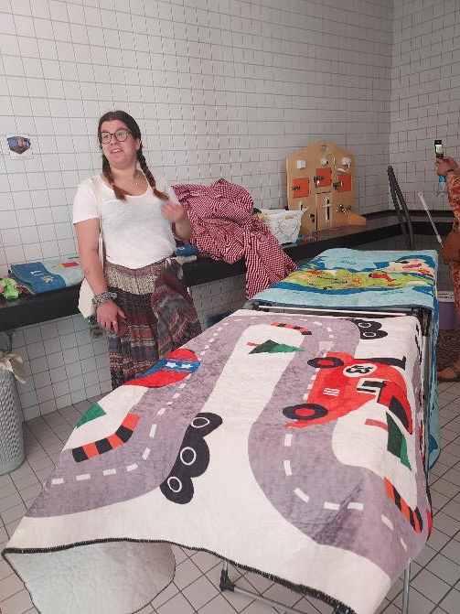
Visit to Selcuklu Autistic Individuals Education (SOBE) Foundation
Obtaining information about individual education practices for individuals with autism
Observing educational environments

Slide 9
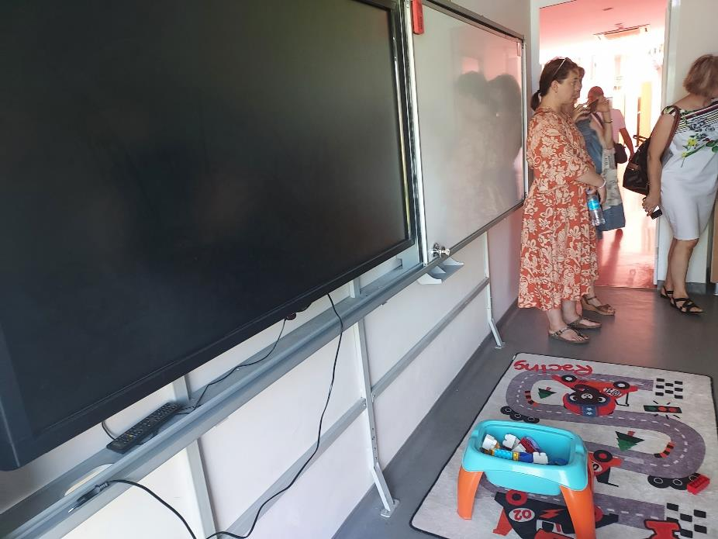
Visit to Selcuklu Autistic Individuals Education (SOBE) Foundation
Obtaining information about individual education practices for individuals with autism
Observing educational environments

Slide 10
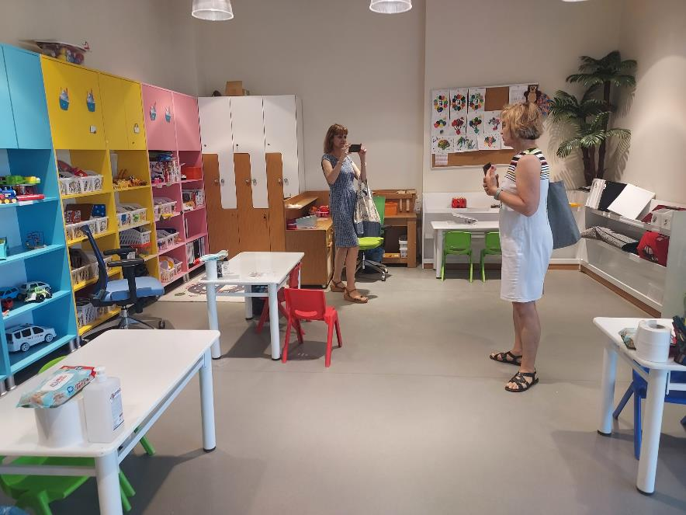
Visit to Selcuklu Autistic Individuals Education (SOBE) Foundation
Obtaining information about individual education practices for individuals with autism
Observing educational environments

Slide 11
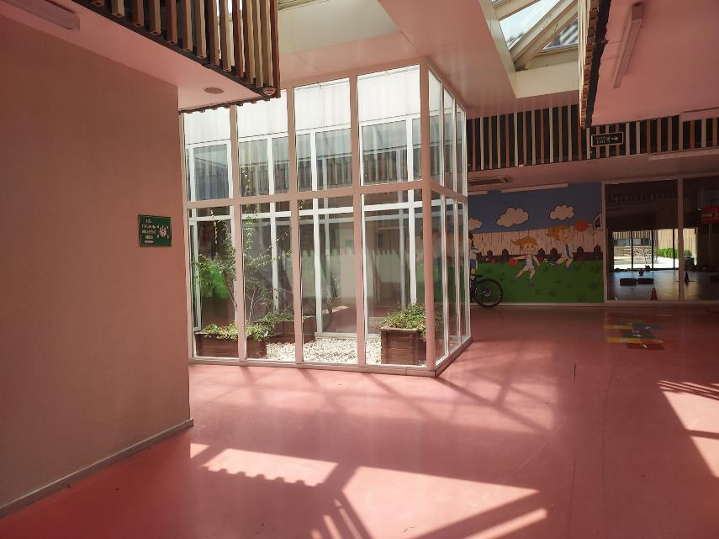
Visit to Selcuklu Autistic Individuals Education (SOBE) Foundation
Obtaining information about individual education practices for individuals with autism
Observing educational environments

Slide 12
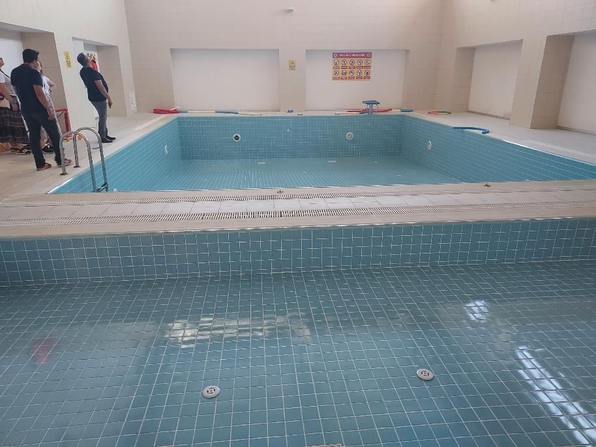
Visit to Selcuklu Autistic Individuals Education (SOBE) Foundation
Obtaining information about individual education practices for individuals with autism
Observing educational environments

Slide 13
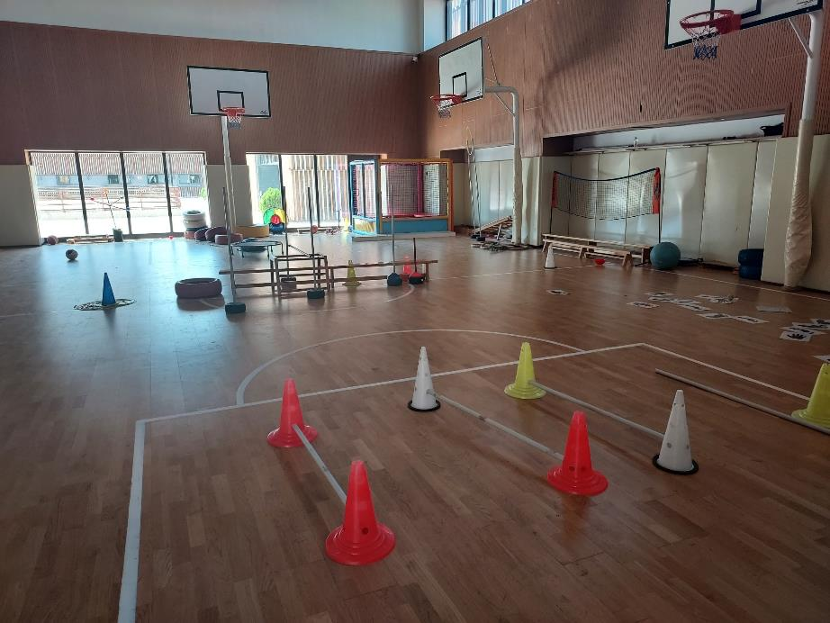
Visit to Selcuklu Autistic Individuals Education (SOBE) Foundation
Obtaining information about individual education practices for individuals with autism
Observing educational environments

Slide 14
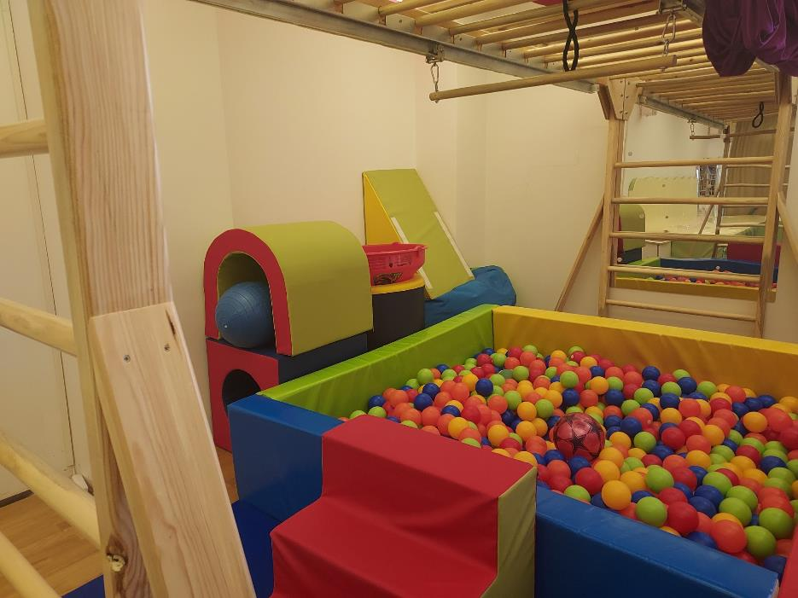
Visit to Selcuklu Autistic Individuals Education (SOBE) Foundation
Obtaining information about individual education practices for individuals with autism
Observing educational environments

Slide 15
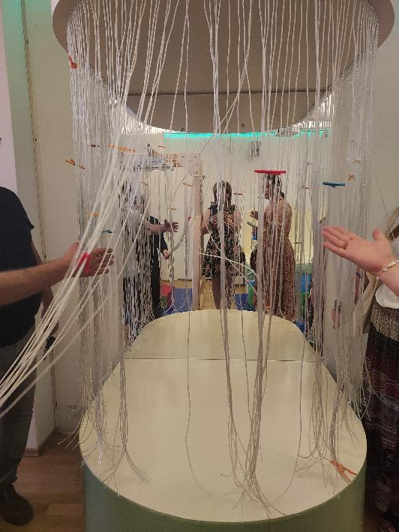
Visit to Selcuklu Autistic Individuals Education (SOBE) Foundation
Obtaining information about individual education practices for individuals with autism
Observing educational environments

Slide 16
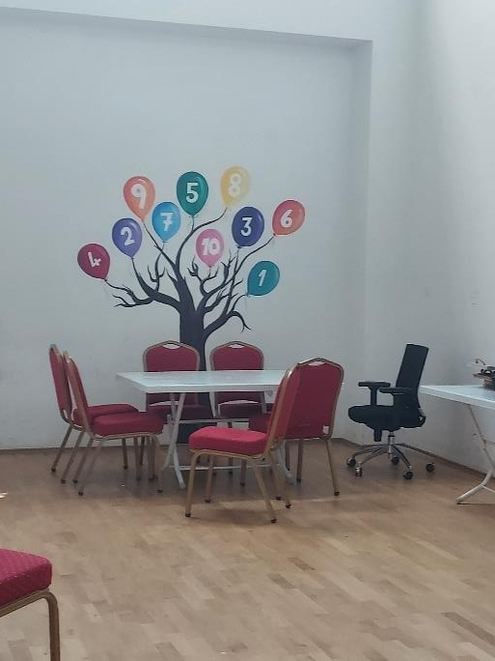
Visit to Selcuklu Autistic Individuals Education (SOBE) Foundation
Obtaining information about individual education practices for individuals with autism
Observing educational environments

Slide 17
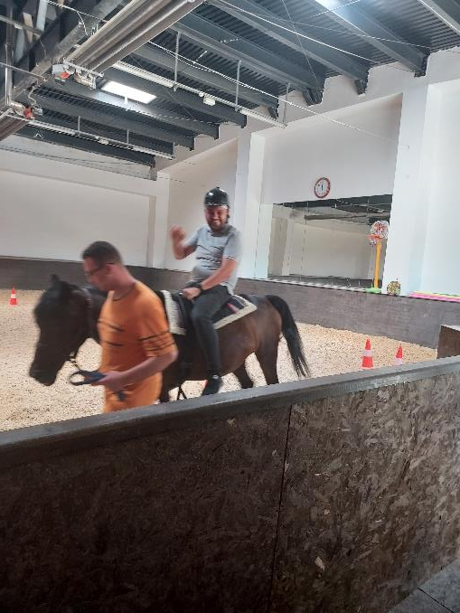
Visit to Selcuklu Autistic Individuals Education (SOBE) Foundation
Obtaining information about individual education practices for individuals with autism
Observing educational environments

Slide 18
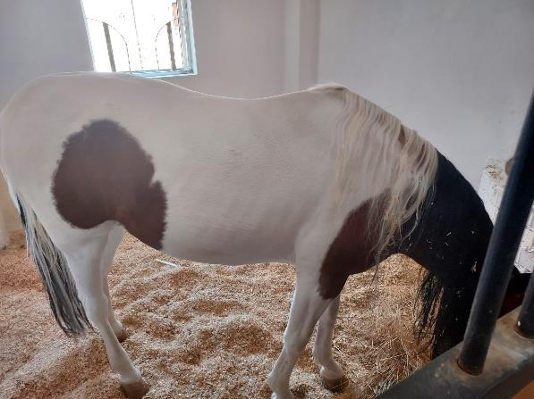
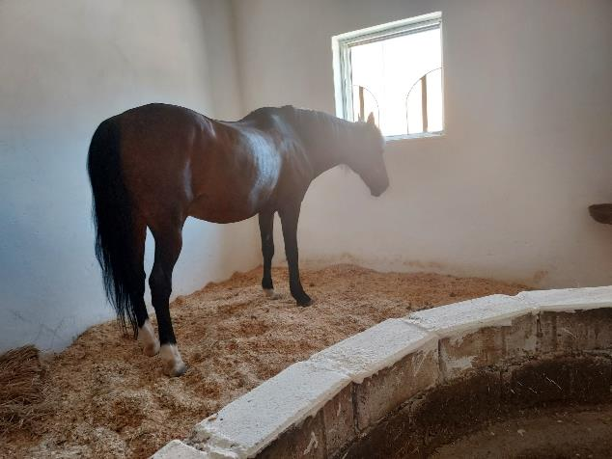

Slide 19
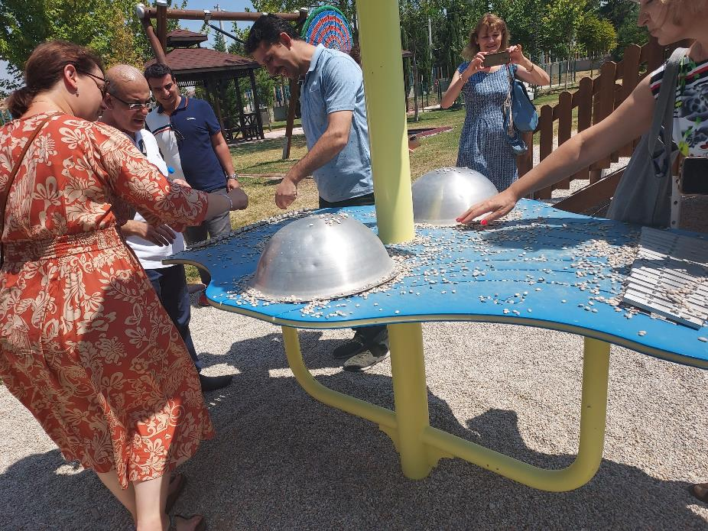

Slide 20
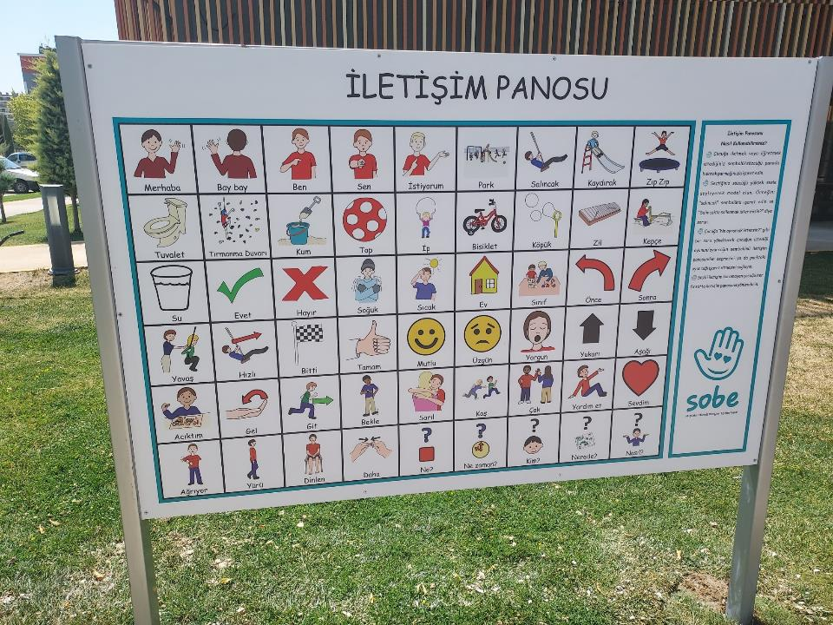

Slide 21
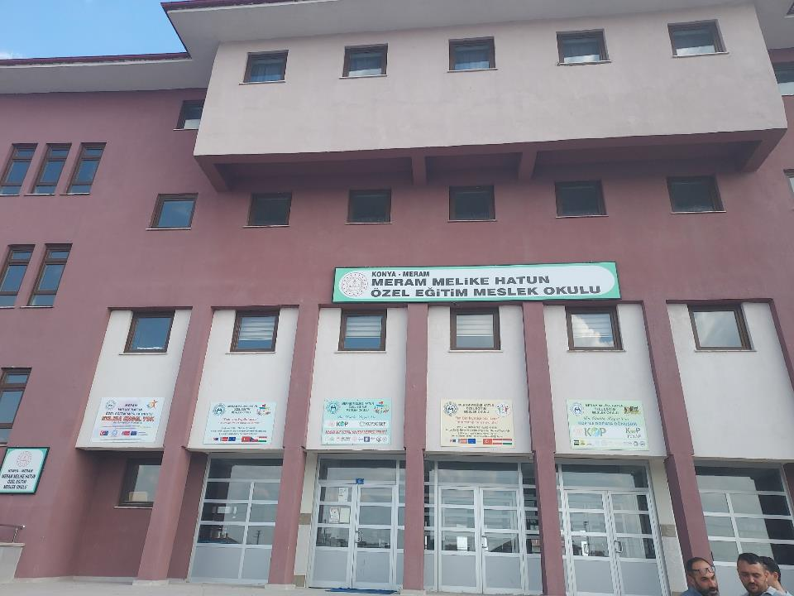
Visit to Meram Melike Hatun Special Education Vocational School

Slide 22
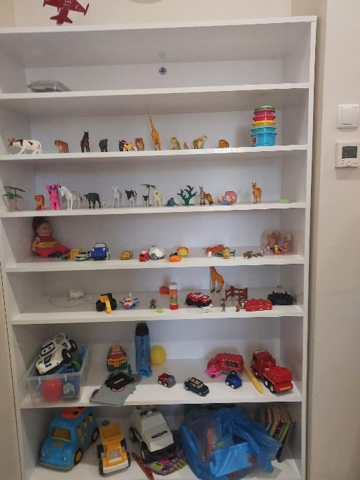
Visit to Meram Melike Hatun Special Education Vocational School – observing the vocational training of individuals with special educational needs

Slide 23
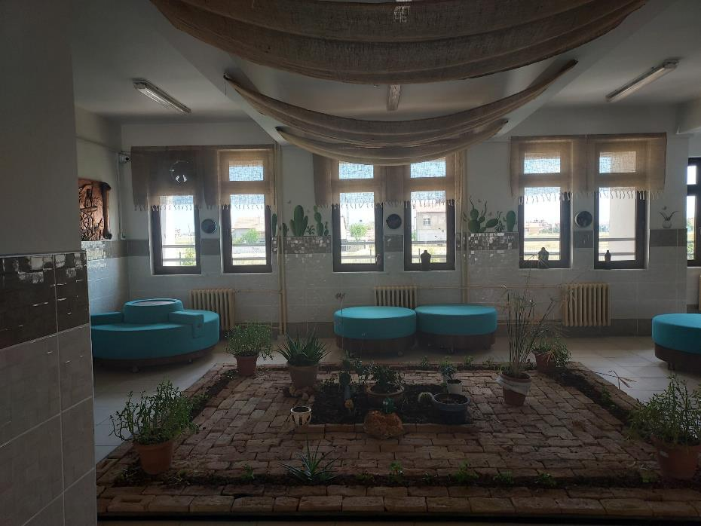
Visit to Meram Melike Hatun Special Education Vocational School
Waiting room for parents

Slide 24
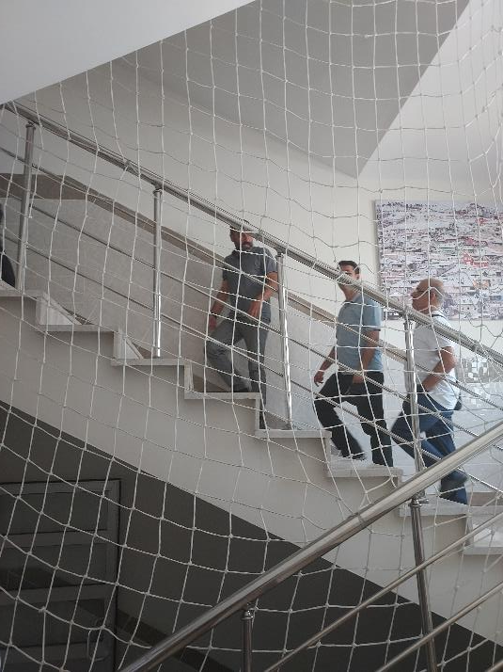
Visit to Meram Melike Hatun Special Education Vocational School – observing the vocational training of individuals with special educational needs

Slide 25
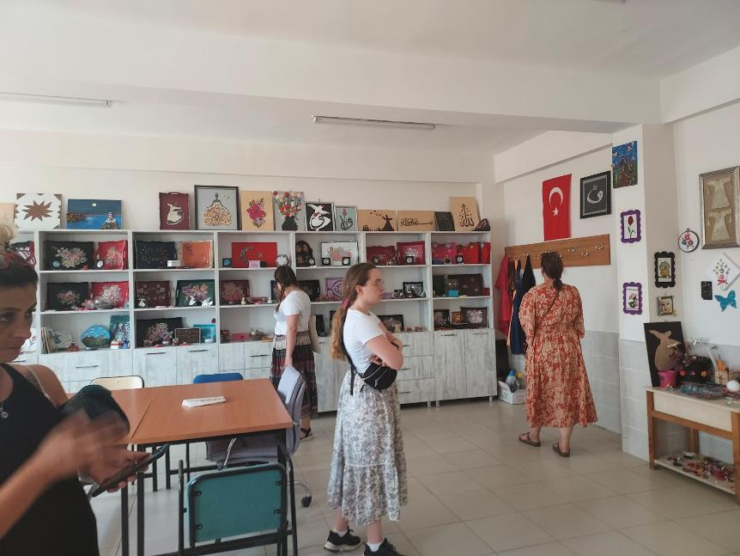
Visit to Meram Melike Hatun Special Education Vocational School – observing the vocational training of individuals with special educational needs
Printing, Handicrafts

Slide 26
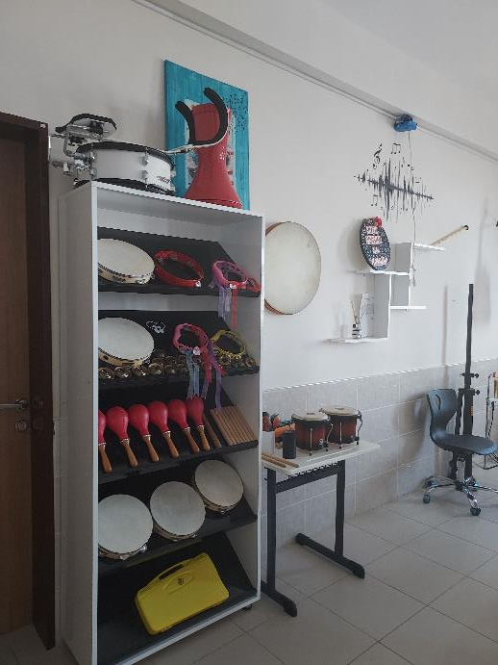
Visit to Meram Melike Hatun Special Education Vocational School – observing the vocational training of individuals with special educational needs
Music Hall

Slide 27
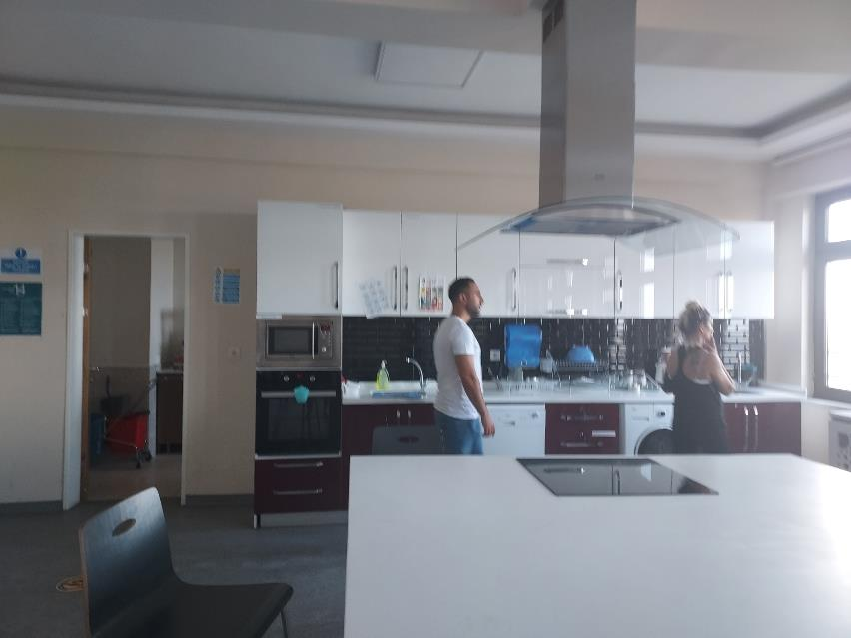
Visit to Meram Melike Hatun Special Education Vocational School – observing the vocational training of individuals with special educational needs
Food and Beverage workshop space

Slide 28
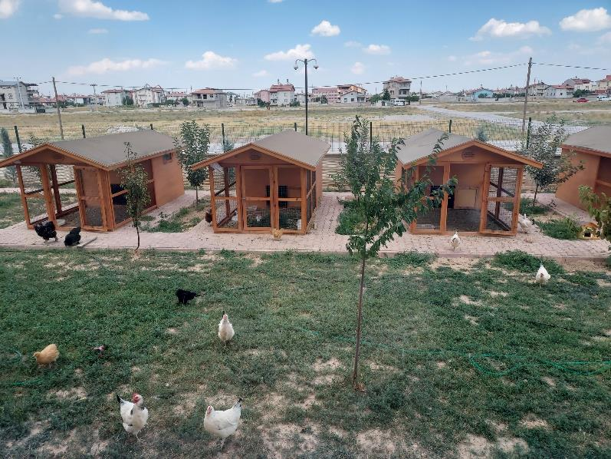
Visit to Meram Melike Hatun Special Education Vocational School – observing the vocational training of individuals with special educational needs
Agriculture space

Slide 29
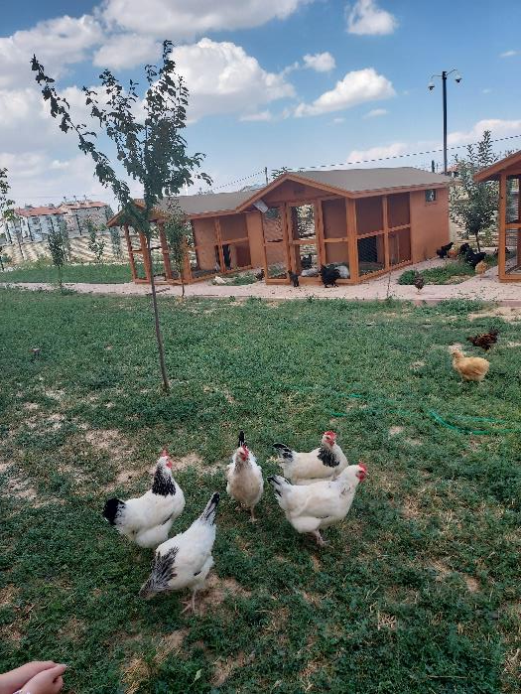
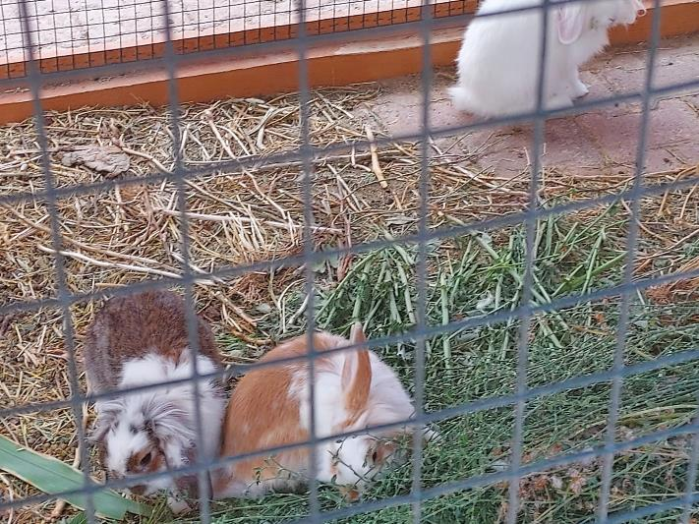

Slide 30
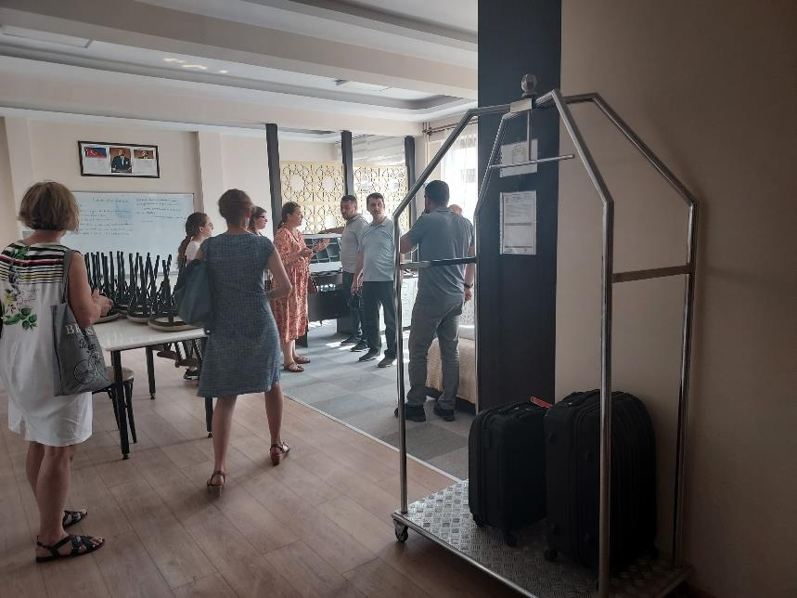
Visit to Meram Melike Hatun Special Education Vocational School – observing the vocational training of individuals with special educational needs
Accommodation and Travel workshop space

Slide 31
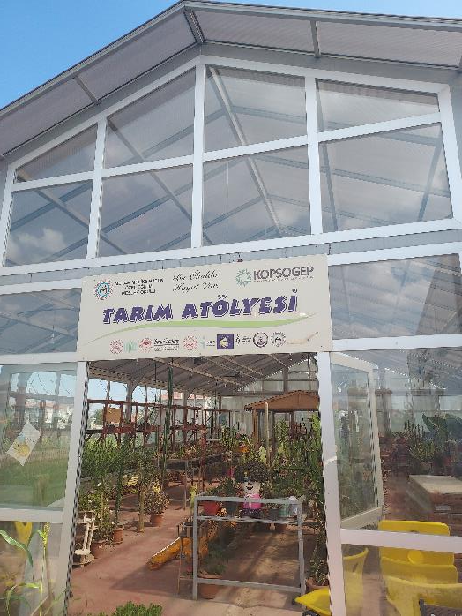
Visit to Meram Melike Hatun Special Education Vocational School – observing the vocational training of individuals with special educational needs

Slide 32
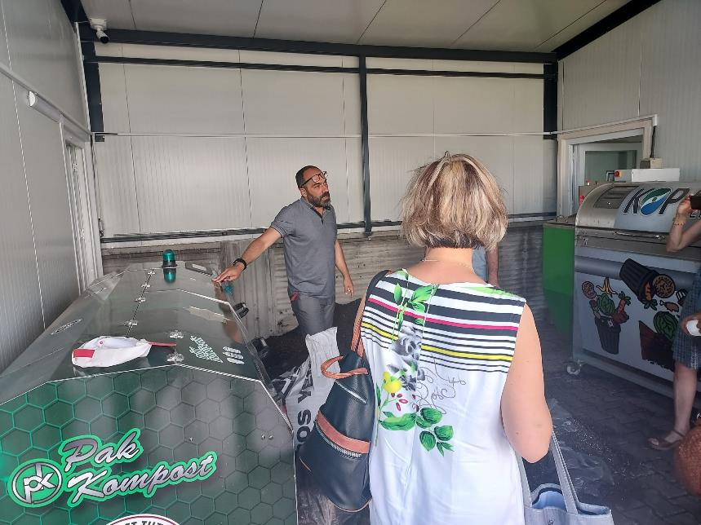
Visit to Meram Melike Hatun Special Education Vocational School – observing the vocational training of individuals with special educational needs
Compost House

Slide 33
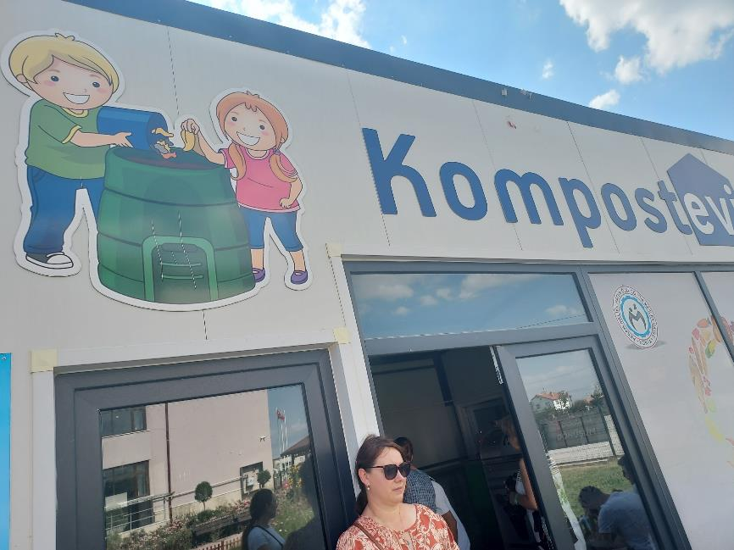
Visit to Meram Melike Hatun Special Education Vocational School – observing the vocational training of individuals with special educational needs
Compost House

Slide 34
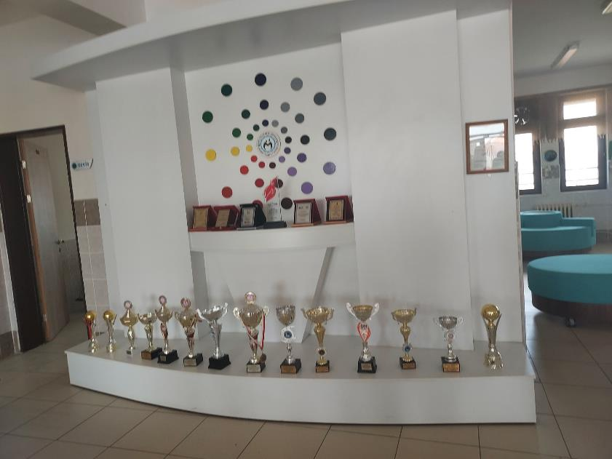
Visit to Meram Melike Hatun Special Education Vocational School
Trophies from the sportive competitions

Slide 35
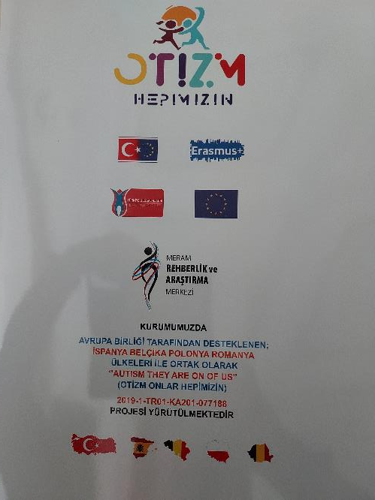
Participants:
Gabriela Conea
Anca Suzan Achitenei

